Slide 1

Covid-19: Data Analysis and Predictive Modelling in R GitHub Link
Shyama Arunachalam, Ankita Dewangswami, Fnu Pratichi, Vidhi Khandelwal, Divya Susmitha Nidamanuri

Slide 2

Why R for Data Analysis?
Utilizes R’s robust statistical tools for in-depth analysis of pandemic trends.
Employs advanced visualization libraries in R to depict complex data clearly and compellingly.
Benefits from the open-source nature of R, ensuring accessibility and collaborative improvements.
Ensures analysis reproducibility and easy updates, crucial for ongoing research during the pandemic.
Integrates with numerous platforms and tools, facilitating comprehensive multi-source analyses.

Slide 3

Dataset & Motivation
Name : OWID COVID-19 Data
Source: Our World in Data
Purpose: The dataset provides comprehensive data on COVID-19 cases, vaccinations, mortality, and various other metrics across countries.
We have 387249 rows and 67 columns (metric) in our dataset providing a rich source of socio-economic and demographic information to analyze trends in viral spread.

Slide 4
Relevance of COVID-19 Data in Analysing Impact and Response
Understanding Public Health Impacts
Economic Analysis
Social Implications
Data-Driven Decision Making
Guides future strategies in pandemic preparedness and management

Slide 5

Data Manipulation
We use various libraries for data reading, transformations and operations such as handling missing data
dplyr – Dataframe manipulation
jsonlite – JSON parser and generator
zoo – Working with ordered observations over time (time-series analysis)

Slide 6
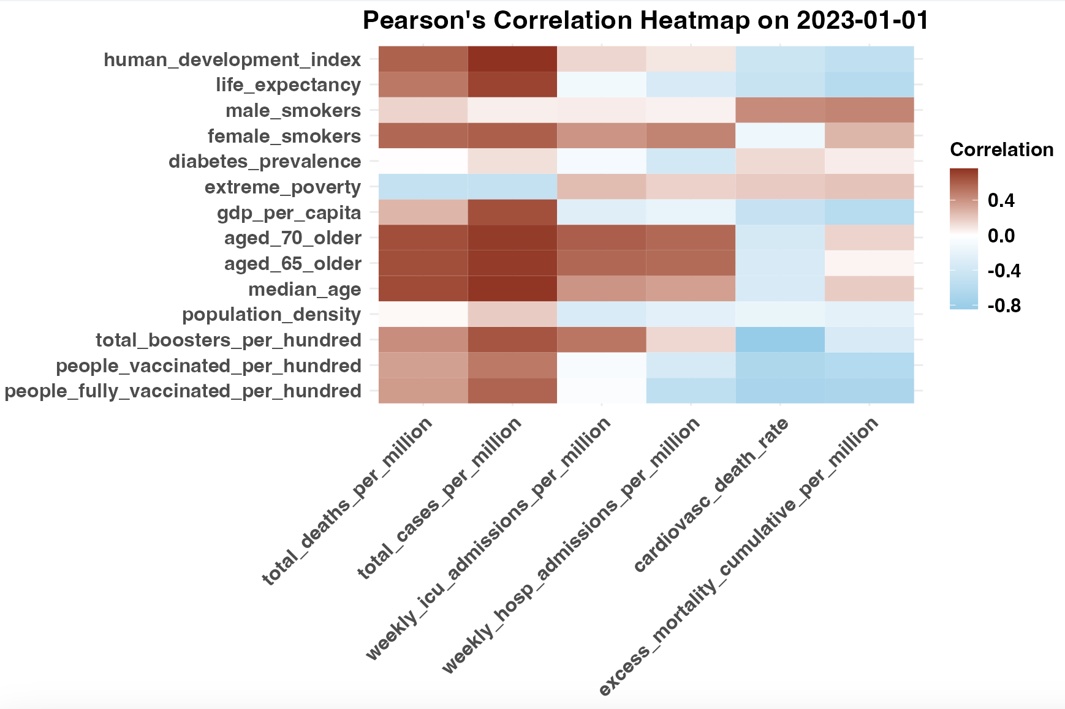
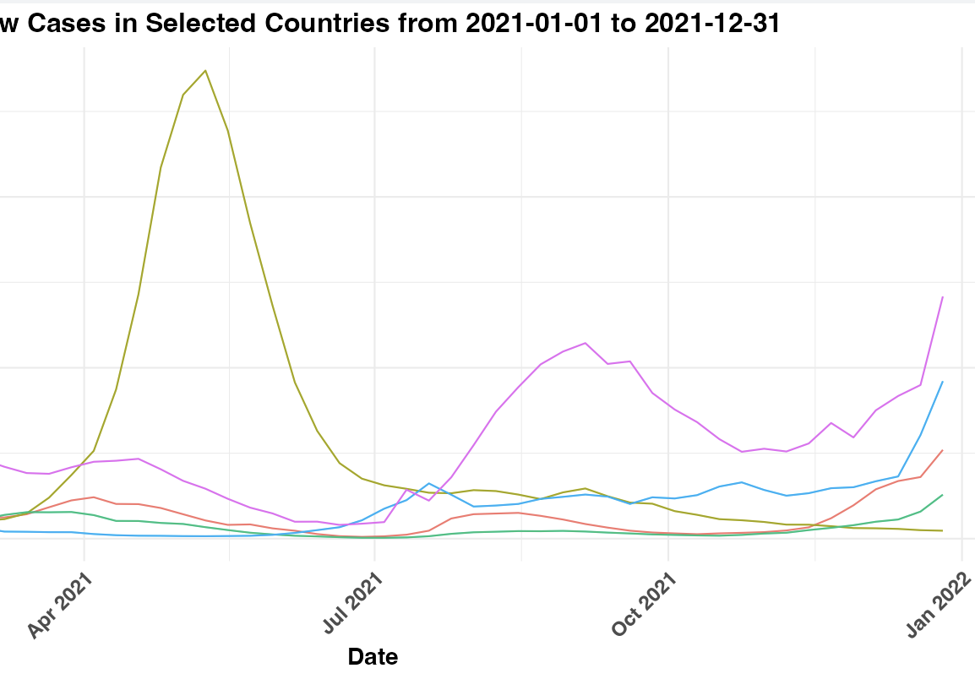
Data Visualization
ggplot2 – declaratively creating graphics in R. Used for creating charts, heatmaps etc.

Slide 7
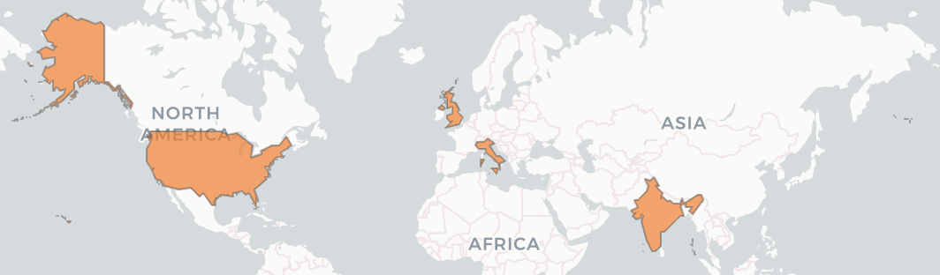
Data Visualization
naturalearth, rnaturalearthdata, leaflet- Tools to handle and visualize map data and creating interactive world maps

Slide 8
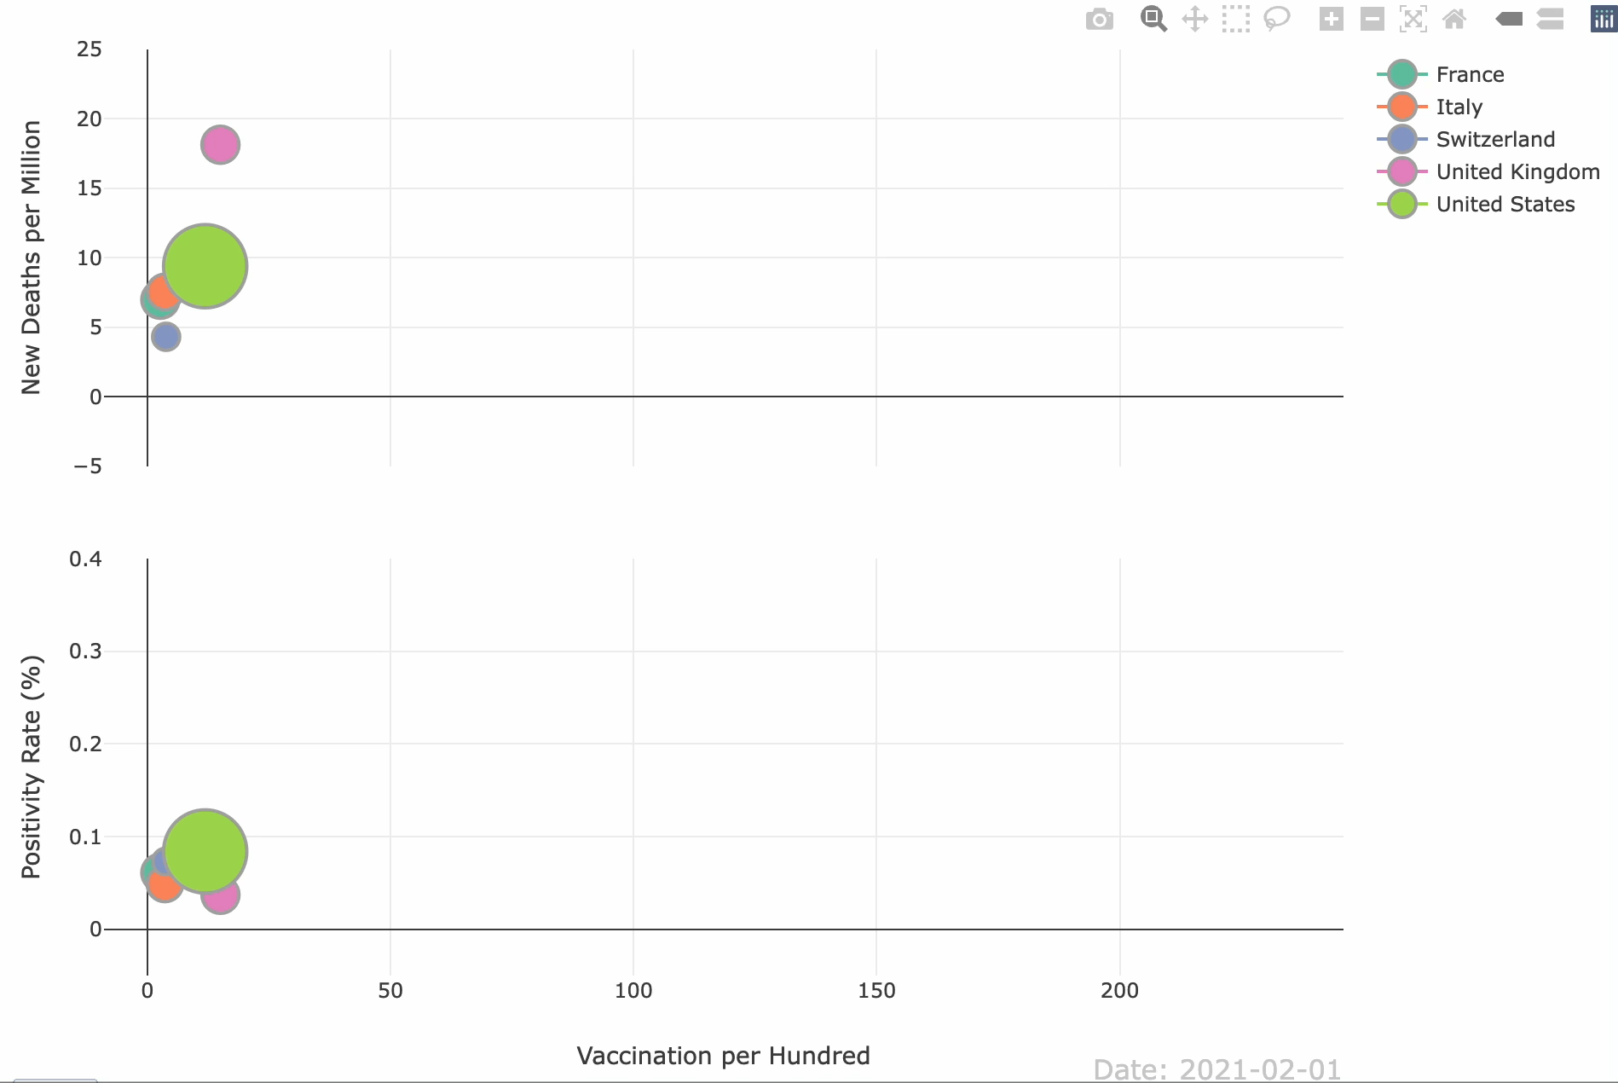
Data Visualization
plotly – An interactive library allowing us to create complex visualizations, informative charts and animations

Slide 9
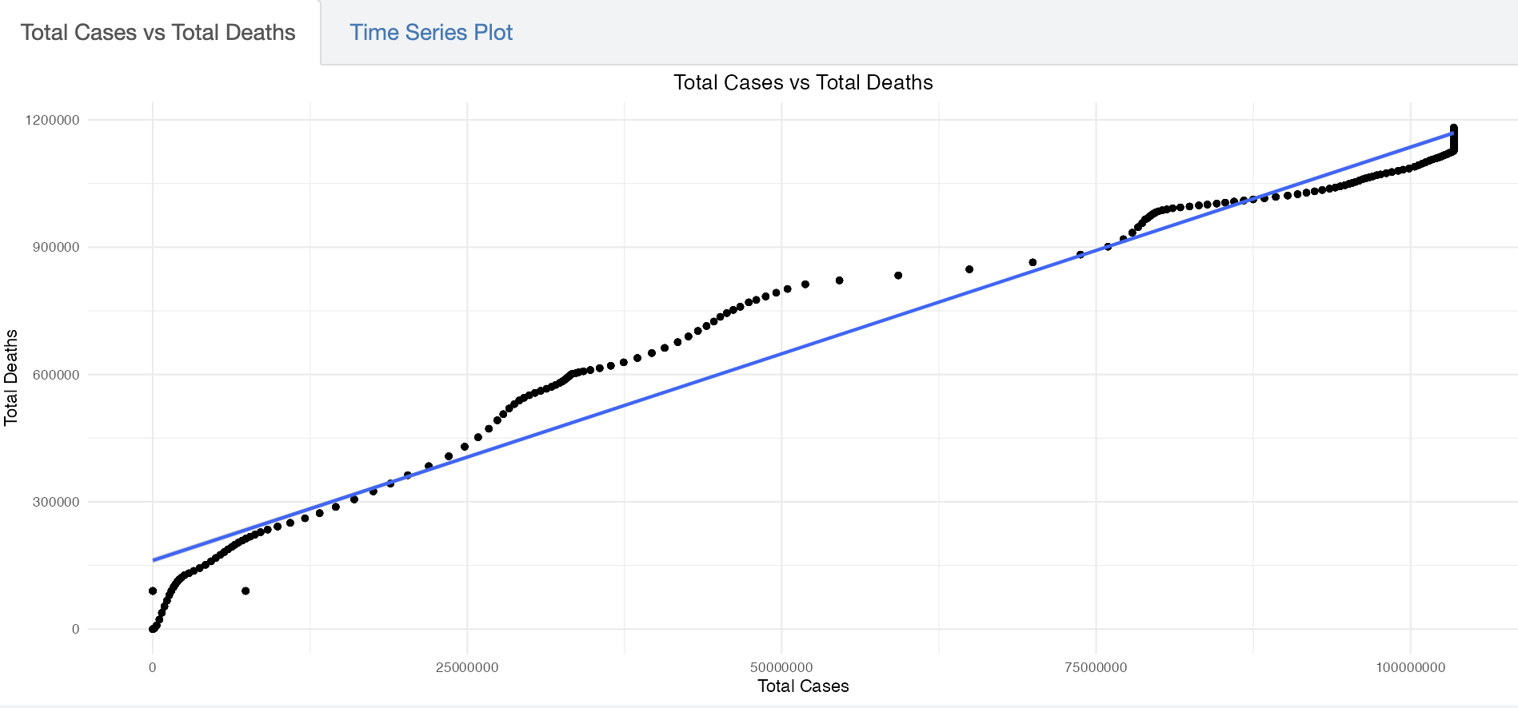
Data Modeling
stats – statistical modeling and predictive analytics in R

Slide 10

Questions?

